Slide 1

•
PROJECT REPORT ON
CAR MANAGEMENT SYSTEM
BY
NAME: SUJAL SINGH BISHT
UID: 23BCA10607
SECTION: 7-B
FOR
COURSE: DATABASE MANAGEMANT SYSTEM
DEPARTMENT: BCA

Slide 2
Car Management System - DBMS Project
1. Introduction
The Car Management System is designed to efficiently manage the records of cars in an organization, such as a car dealership or a rental service. The system maintains data about cars, customers, bookings, and employees, ensuring smooth transactions, inventory management, and customer service. The goal is to provide a reliable and scalable solution for storing and managing car-related information with ease of access.
Objective
To develop a robust database for car management.
To manage details of cars, customers, bookings, and employees.
To simplify the process of car booking, availability checking, and customer management.
To generate useful queries and reports for administration.
To ensure data integrity and easy retrieval of information.
Technologies Used
Database: MySQL / PostgreSQL
Frontend: (Optional) HTML/CSS/PHP or Python with Flask
Backend: SQL Queries
Tool for ER Diagram: Draw.io / Lucidchart / dbdiagram.io
Entity Relationship (ER) Diagram
Entities:
Car
Customer
Booking
Employee
Relationships:
Customer books Car
Employee manages Booking

Slide 3
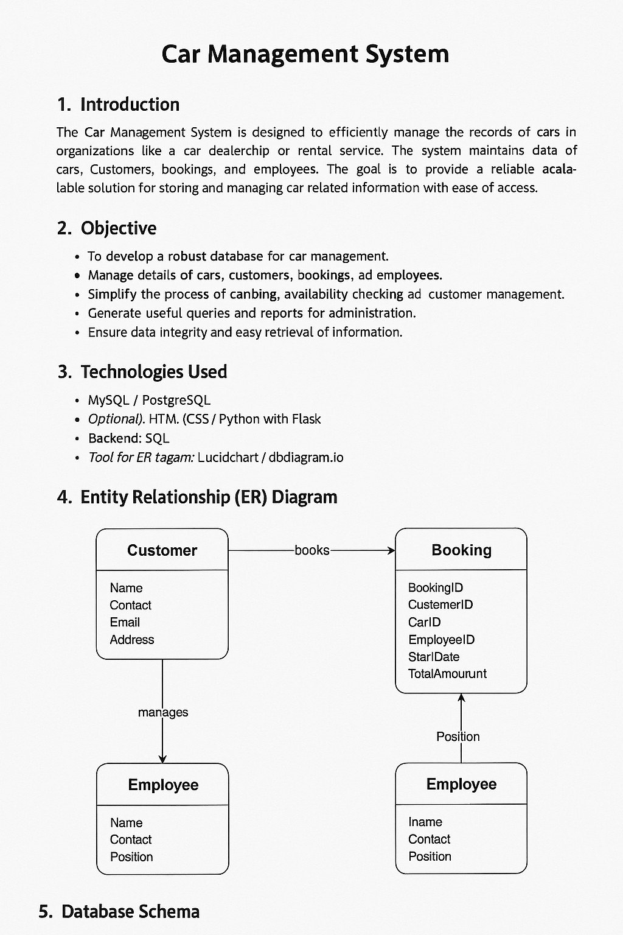
* ER Diagram:

Slide 4
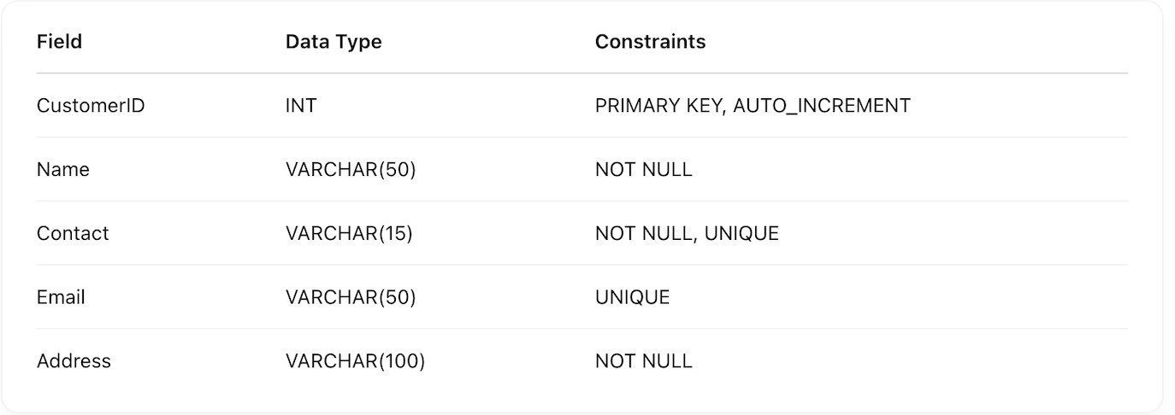
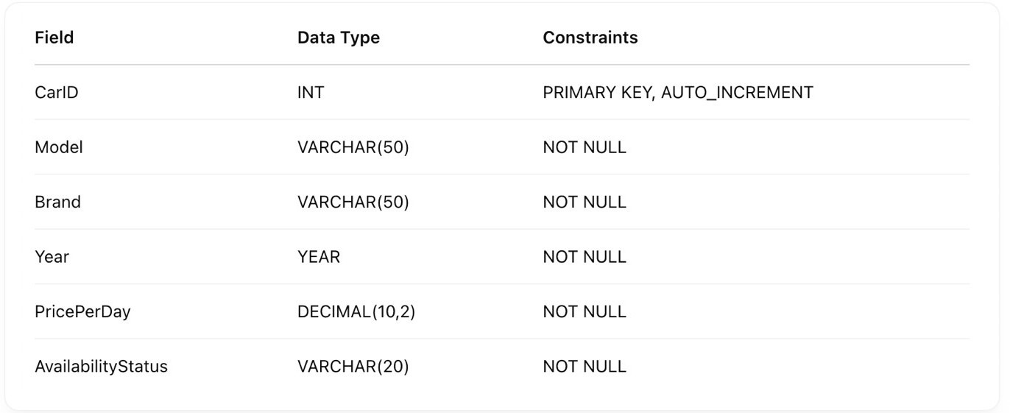
I'll describe it textually:
Customer (CustomerID, Name, Contact, Email, Address)
Car (CarID, Model, Brand, Year, PricePerDay, AvailabilityStatus)
Booking (BookingID, CustomerID, CarID, EmployeeID, StartDate, EndDate, TotalAmount)
Employee (EmployeeID, Name, Contact, Position)
5. Database Schema
Customer
CAR
Employee

Slide 5
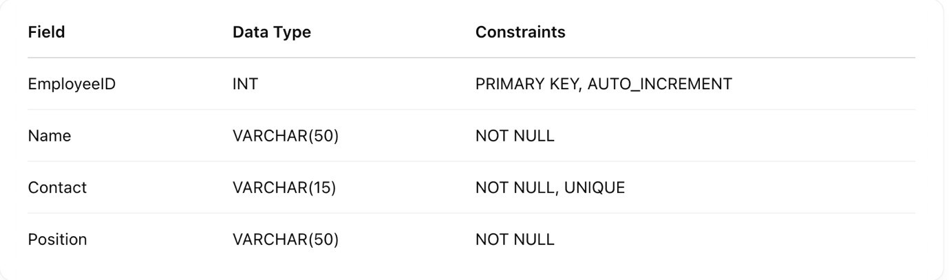
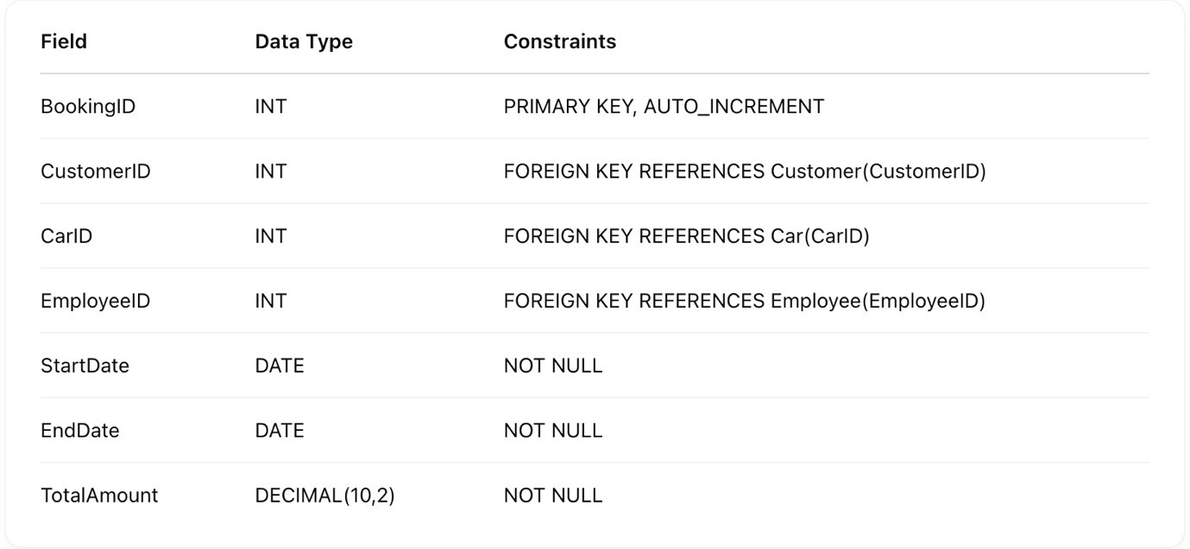
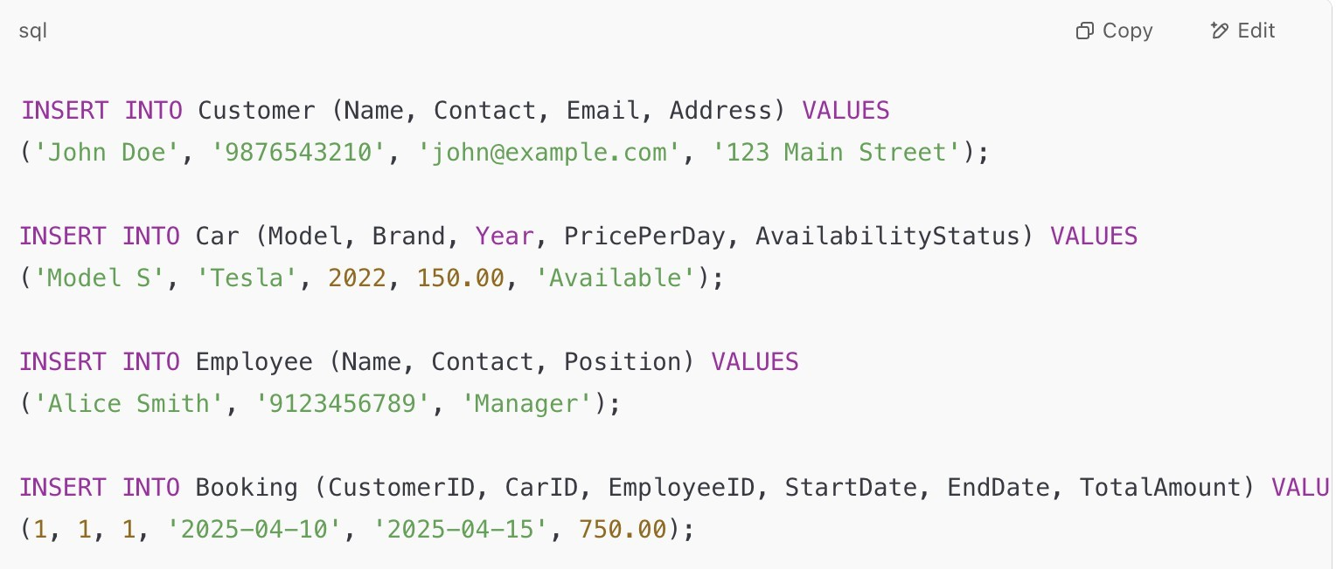
Booking
Sample Queries
Insert Data
b) Display all available cars

Slide 6
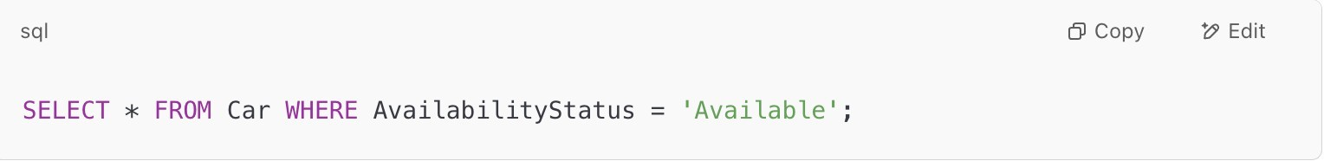
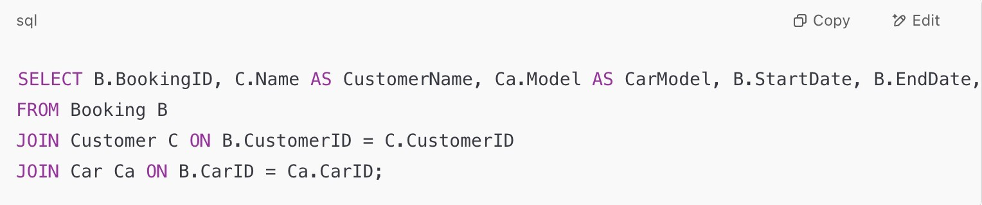
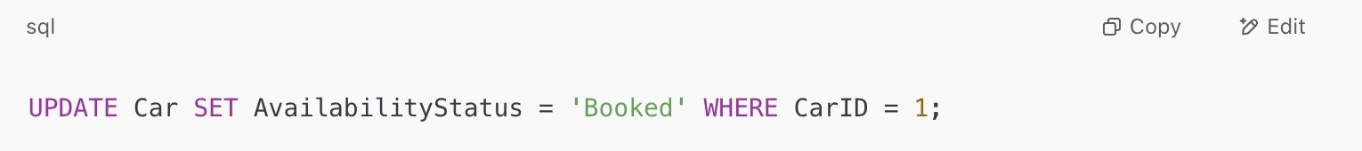
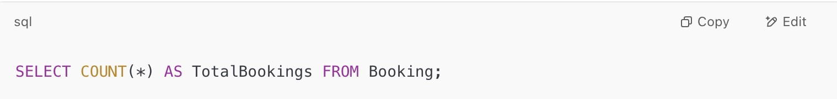
c) List all bookings with customer and car details
d) Update car availability after booking
e) Count total number of bookings
7. Code with Outputs
Here’s an example code using MySQL + Python:

Slide 7
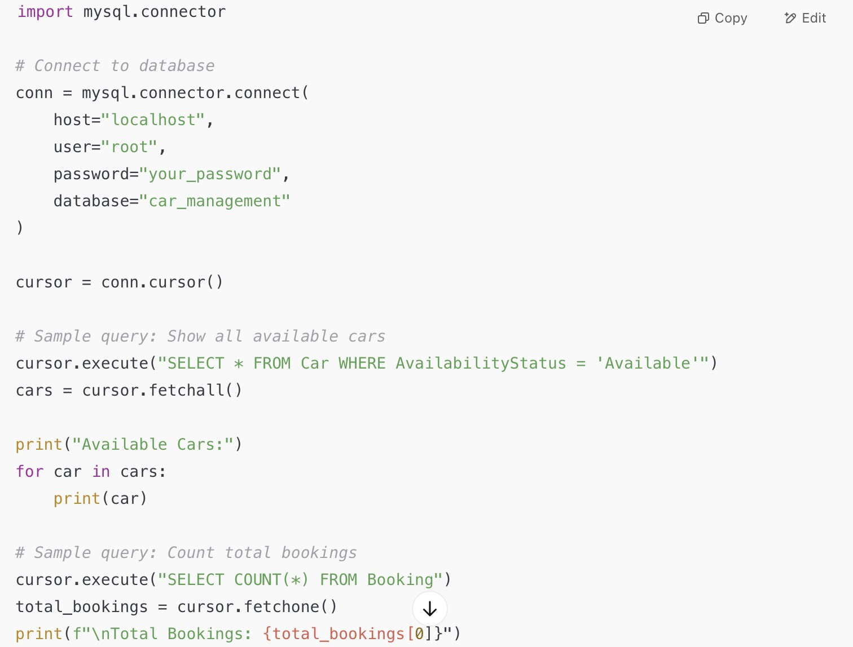
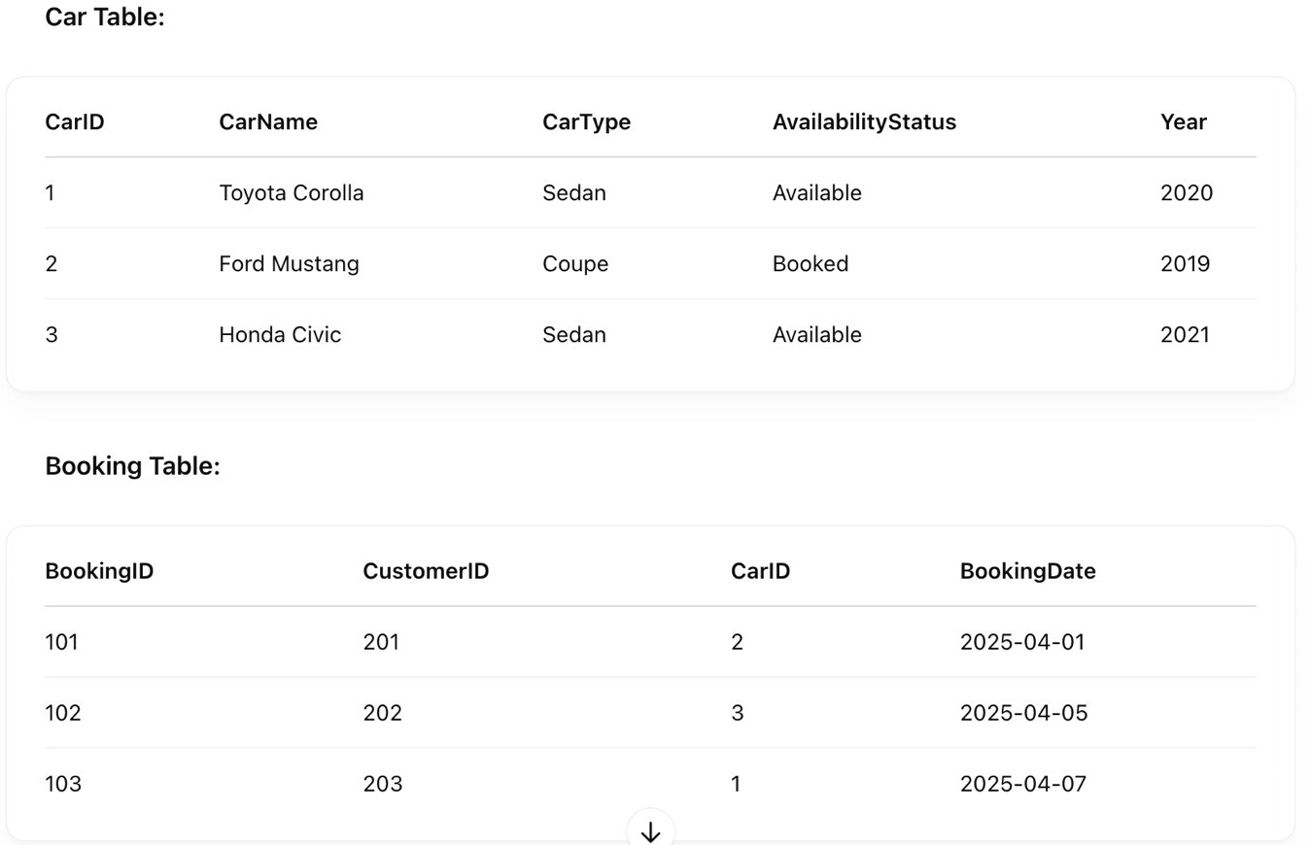
0utput:

Slide 8
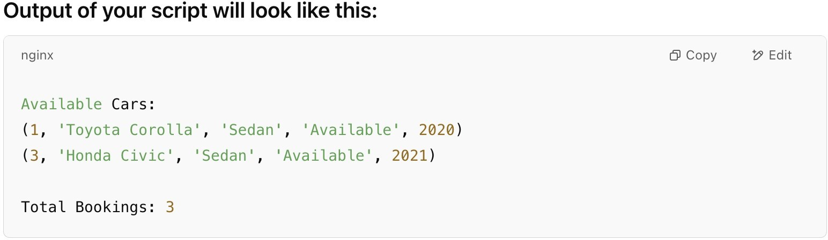
SQL IMPLETATION
CREATE DATABASE car_management; USE car_management;
CREATE TABLE Customer ( CustomerID INT PRIMARY KEY,
CustomerName VARCHAR(100), Phone VARCHAR(15),
Email VARCHAR(100),
Address VARCHAR(255)
);
-- Car Table
CREATE TABLE Car (
CarID INT PRIMARY KEY, CarName VARCHAR(100), CarType VARCHAR(50),
AvailabilityStatus VARCHAR(20), Year INT
);

Slide 9
-- Employee Table
CREATE TABLE Employee ( EmployeeID INT PRIMARY KEY,
EmployeeName VARCHAR(100), Position VARCHAR(50),
Phone VARCHAR(15), Email VARCHAR(100)
);
-- Booking Table
CREATE TABLE Booking ( BookingID INT PRIMARY KEY,
CustomerID INT, CarID INT,
EmployeeID INT, BookingDate DATE,
FOREIGN KEY (CustomerID) REFERENCES Customer(CustomerID), FOREIGN KEY (CarID) REFERENCES Car(CarID),
FOREIGN KEY (EmployeeID) REFERENCES Employee(EmployeeID)
);
-- 3. Insert Sample Data
-- Customers
INSERT INTO Customer VALUES (201, 'John Doe', '9876543210',
'john@example.com', '123 Main St');

Slide 10
INSERT INTO Customer VALUES (202, 'Jane Smith', '9123456789',
'jane@example.com', '456 Park Ave');
INSERT INTO Customer VALUES (203, 'Mike Johnson', '9988776655',
'mike@example.com', '789 Oak Rd');
-- Cars
INSERT INTO Car VALUES (1, 'Toyota Corolla', 'Sedan', 'Available', 2020); INSERT INTO Car VALUES (2, 'Ford Mustang', 'Coupe', 'Booked', 2019); INSERT INTO Car VALUES (3, 'Honda Civic', 'Sedan', 'Available', 2021);
-- Employees
INSERT INTO Employee VALUES (301, 'Alice Brown', 'Manager', '8899776655', 'alice@example.com');
INSERT INTO Employee VALUES (302, 'Bob Martin', 'Sales Executive', '7766554433', 'bob@example.com');
-- Bookings
INSERT INTO Booking VALUES (101, 201, 2, 301, '2025-04-01');
INSERT INTO Booking VALUES (102, 202, 3, 302, '2025-04-05');
INSERT INTO Booking VALUES (103, 203, 1, 301, '2025-04-07');
-- 4. Sample Queries
-- a) Display all available cars
SELECT * FROM Car WHERE AvailabilityStatus = 'Available';
-- b) Count total number of bookings

Slide 11
SELECT COUNT(*) AS TotalBookings FROM Booking;
-- c) List all bookings with customer and car details
SELECT Booking.BookingID, Customer.CustomerName, Car.CarName, Booking.BookingDate
FROM Booking
JOIN Customer ON Booking.CustomerID = Customer.CustomerID JOIN Car ON Booking.CarID = Car.CarID;
-- d) Update car availability after booking
UPDATE Car SET AvailabilityStatus = 'Booked' WHERE CarID = 3;
-- e) Show all employees handling bookings
SELECT DISTINCT Employee.EmployeeID, Employee.EmployeeName FROM Booking
JOIN Employee ON Booking.EmployeeID = Employee.EmployeeID;
8. Conclusion
The Car Management System streamlines the operations of car-related businesses by digitizing customer details, car inventory, employee management, and bookings. With a well- designed relational database, data retrieval and management become efficient, reducing manual errors and improving service delivery. Future enhancements can include features like payment integration, real-time car availability updates, and customer feedback modules.

